Slide 1
INTRO TO DATA VISUALIZATIONS

Slide 2
Goals for
Understand what makes a visualization effective through the study of core principles
Critically evaluate a visual representation of data by looking at various examples in media (newspapers, television and so on)
Gain hands-on experience with visualization tools /libraries
Incorporate visualization principles to build an interactive visualization of your own data

Slide 3

What is Data Visualization?
Visual representation of data
For the purpose of exploration, discovery, and insight

Slide 4

Why is Data Visualization important?
Data Visualization is an important part of EDA.

Slide 5
Why is Data Visualization important?
Baby Name Wizard
http://www.babynamewizard.com/voyager
Origin of Species – Edits
http://benfry.com/traces/
Netflix Queues
http://www.nytimes.com/interactive/2010/01/10/nyregion/20100110-netflix-map.html?ref=nyregion
Unemployment Visualization (NYTimes)
http://www.nytimes.com/interactive/2009/11/06/business/economy/unemployment-lines.html
r/dataisbeautiful subreddit

Slide 6
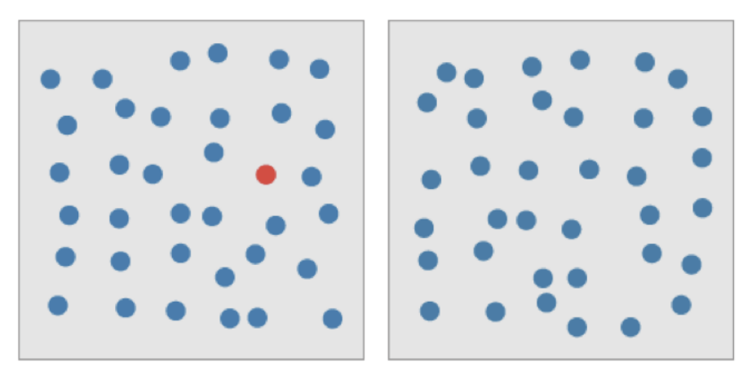
Why is visualization important?
Vision is the most powerful communication channel humans posses.
For instance, We can detect information faster than our eye can move ...
1) Preattentive features can be detected faster
than eye movement (200 msec).
2) Humans are not very good at detecting patterns from numbers.

Slide 7
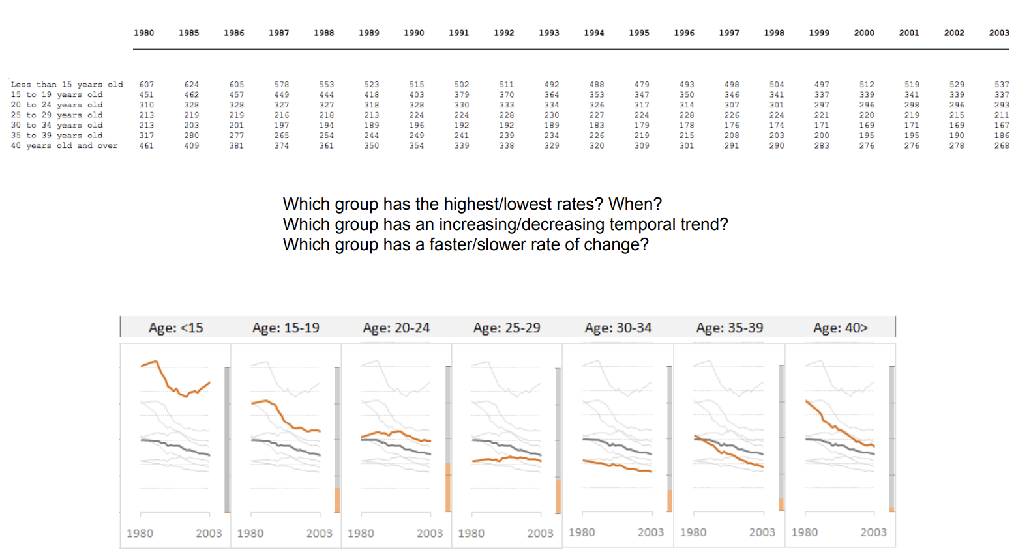

Slide 8
Why is visualization important?
Vision is the most powerful communication channel humans posses.
For instance, We can detect information faster than our eye can move ...
1) Preattentive features can be detected faster
than eye movement (200 msec).
2) Humans are not very good at detecting patterns from numbers.
3) Summary statistics can hide important information

Slide 9
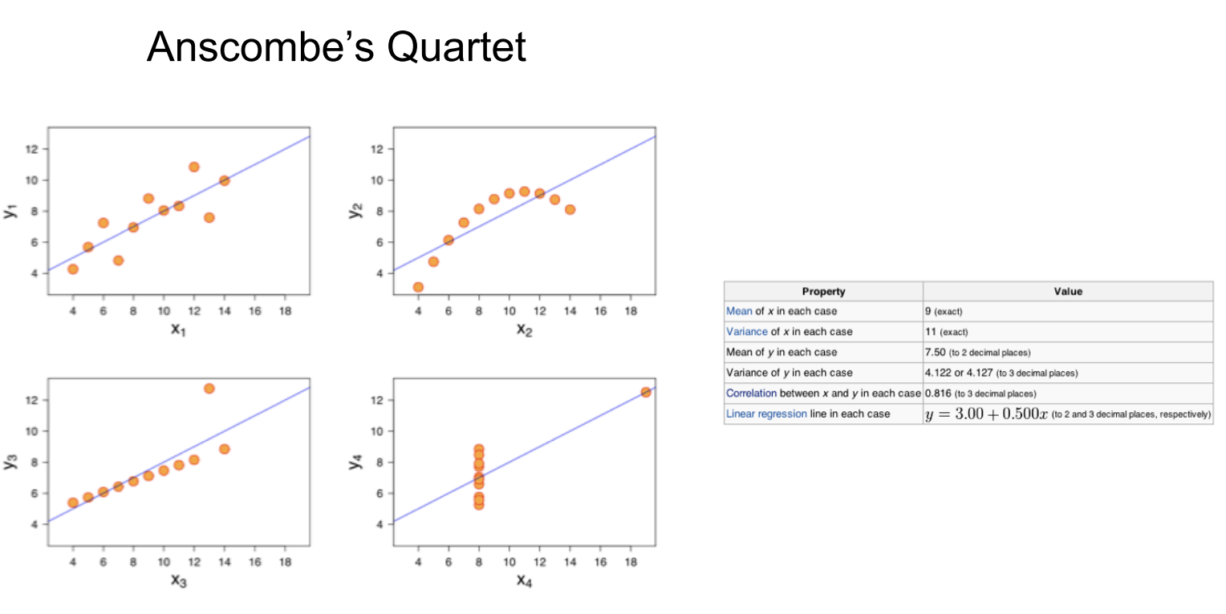

Slide 10
Principles for good data visualizations
1. Balance the design
A balanced design is one with the visual elements like shape, color, negative space and texture equally distributed across the plot.
There are three different types of balances in design:
Symmetrical – Each side of the visual is the same as the other.
Asymmetrical – Both sides are different but still have a similar visual weight.
Radial – Elements are placed around a central object which acts as an anchor.

Slide 11

Principles for good data visualizations
Emphasize the key areas
The user’s attention should be drawn to the right data points by carefully choosing the size, colors, contrast and negative space.

Slide 12
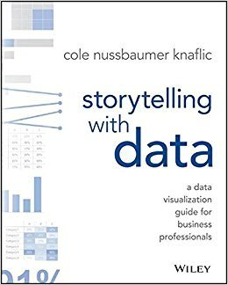
Principles for good data visualizations
Check out this book on the UCR library (available online)

Slide 13
Problems with building visualizations
There’s simply too much data.
Too many dimensions/features.
Too many options and possible views.

Slide 14
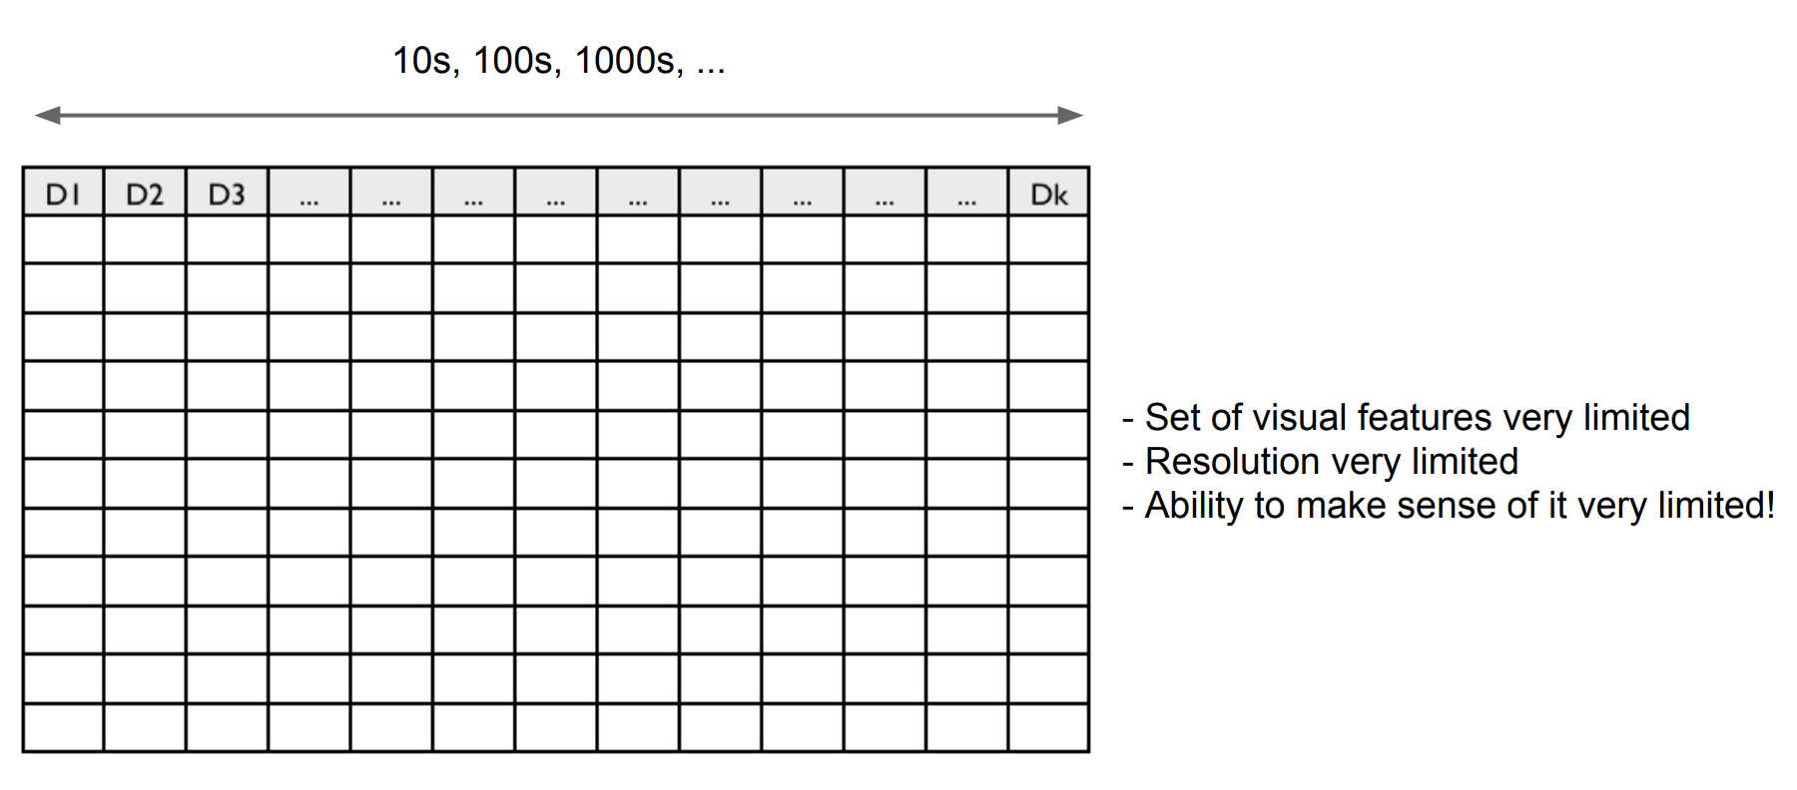
High-Dimensional Data Visualization

Slide 15
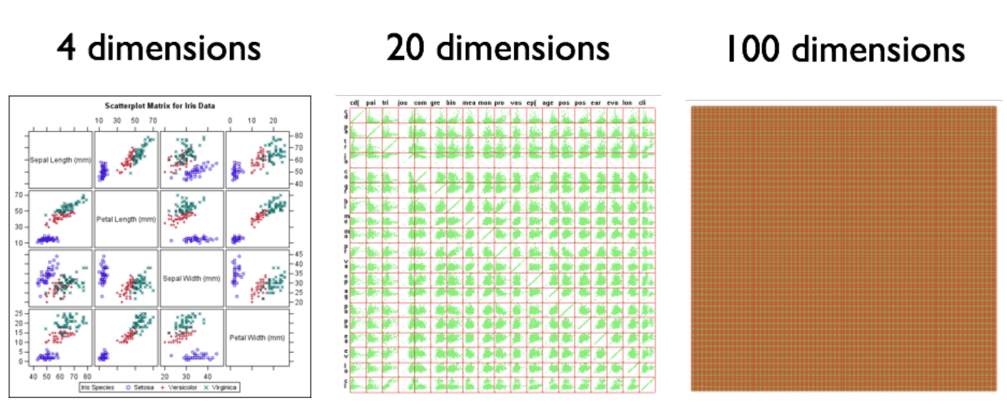
Example: Scatter Plot Matrix
Taken from: Jing Yang’s Interactive Hierarchical Dimension Ordering, Spacing and Filtering for Exploration of High Dimensional Datasets.

Slide 16
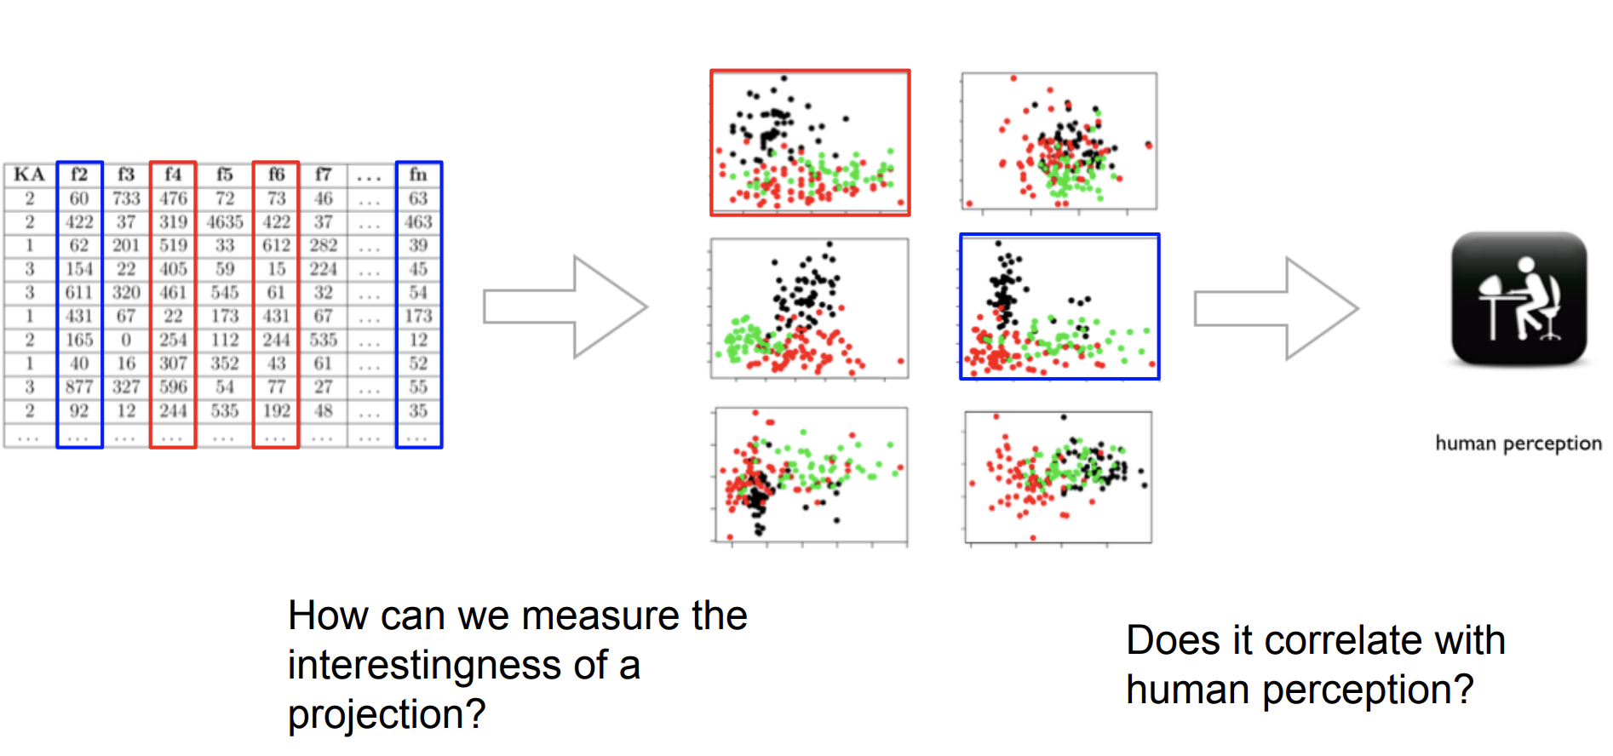
Quality Metrics-Driven Visualization

Slide 17
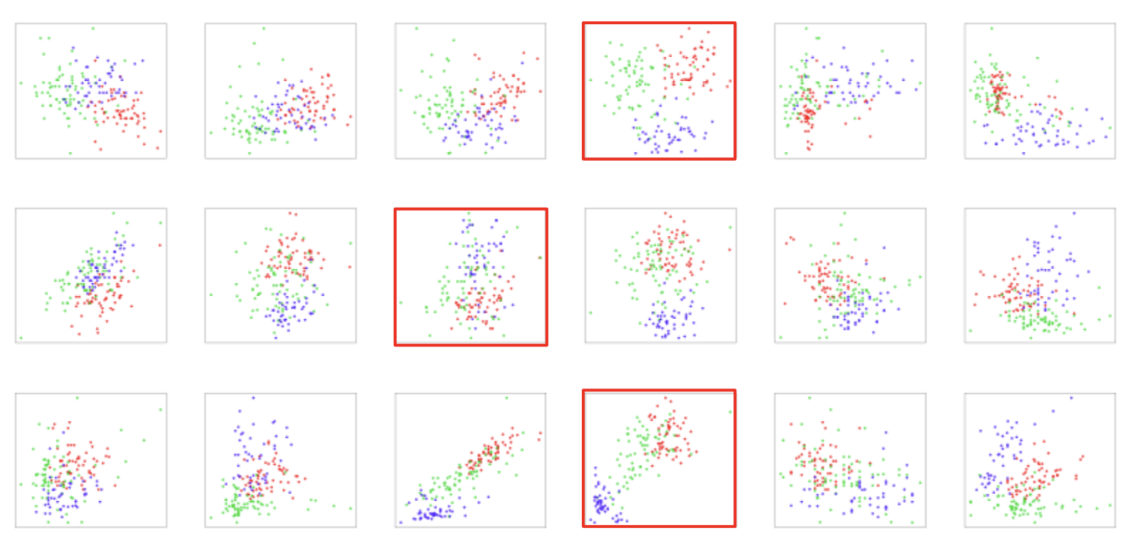
Automatic Ranking of Class Separation

Slide 18
Many features
When we have more than three to four quantitative variables, all-against-all scatter plot matrices quickly become unwieldy.
Dimension reduction relies on the key insight that most high-dimensional datasets consist of multiple correlated variables that convey overlapping information.
Such datasets can be reduced to a smaller number of key dimensions without loss of much critical information.

Slide 19
DIMENSIONALITY REDUCTION

Slide 20
Curse of Dimensionality
The curse of dimensionality refers to various phenomena that arise when analyzing and visualizing data in high-dimensional spaces.
Dimensionality Reduction
It reduces the time and storage space required for our Machine Learning algorithms
Removal of multi-collinear features improves the performance of the machine learning model.
It becomes easier to visualize the data when reduced to very low dimensions such as 2D or 3D.

Slide 21
Dimensionality Reduction
The main idea: reduce the dimensionality of the space.
Project the d-dimensional points in a k-dimensional space so that:
k << d
distances are preserved as well as possible
Solve the problem in low dimensions

Slide 22
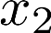
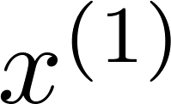
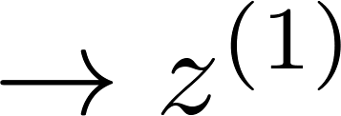
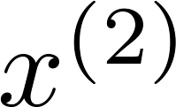
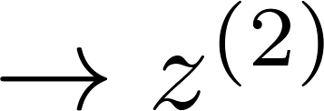
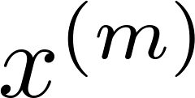
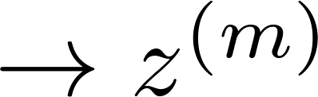
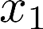
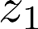
Data Compression
Reduce data from
2D to 1D
(inches)
(cm)
Notes:
Add more unique colors (3-4)

Slide 23
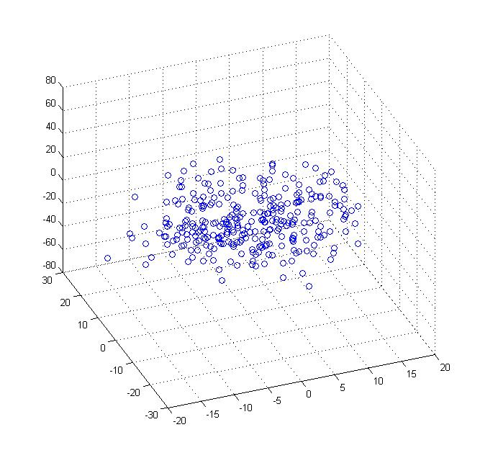
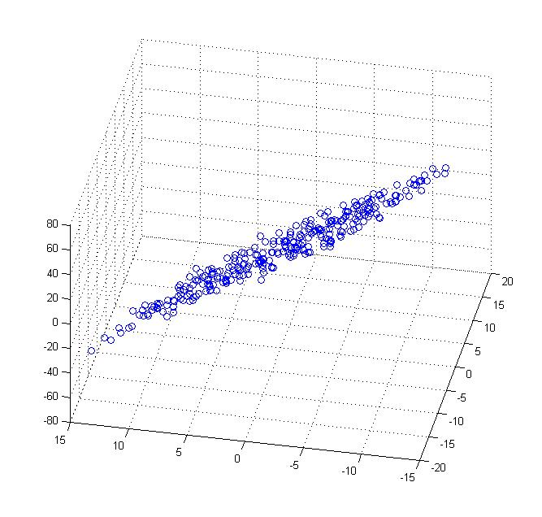
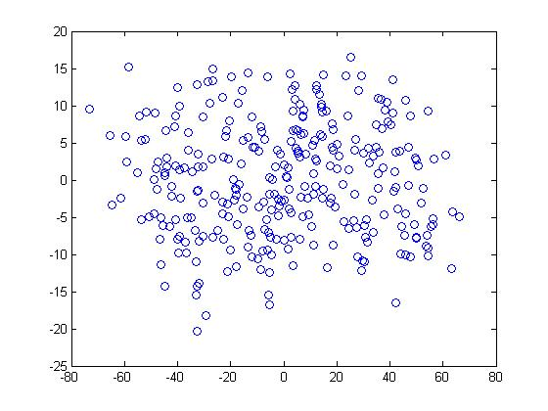
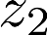
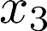
Data Compression
Reduce data from 3D to 2D
Z₁
Z₂
Notes:
This example reduce 3D to 2D
But typically, you are reducing from 10K to 1K

Slide 24
Data Visualization
Country | GDP (trillions of US$) | Per capita GDP (thousands of intl. $) | Human Development Index | Life expectancy | Poverty Index (Gini as percentage) | Mean household income (thousands of US$) | …
Canada | 1.577 | 39.17 | 0.908 | 80.7 | 32.6 | 67.293 | …
China | 5.878 | 7.54 | 0.687 | 73 | 46.9 | 10.22 | …
India | 1.632 | 3.41 | 0.547 | 64.7 | 36.8 | 0.735 | …
Russia | 1.48 | 19.84 | 0.755 | 65.5 | 39.9 | 0.72 | …
Singapore | 0.223 | 56.69 | 0.866 | 80 | 42.5 | 67.1 | …
USA | 14.527 | 46.86 | 0.91 | 78.3 | 40.8 | 84.3 | …
… | … | … | … | … | … | …
X₁
X₂
X₃
X₄
X₅
X₅
[resources from en.wikipedia.org]
Notes:
Having 50 features, its difficult to plot and visuallize the data
Instead of having each country being represented by 50 features, lets say we come up with differnet feature representation
z1 and z2 that summarize these 50 features.
We can plot that and be able to visualize the data better

Slide 25
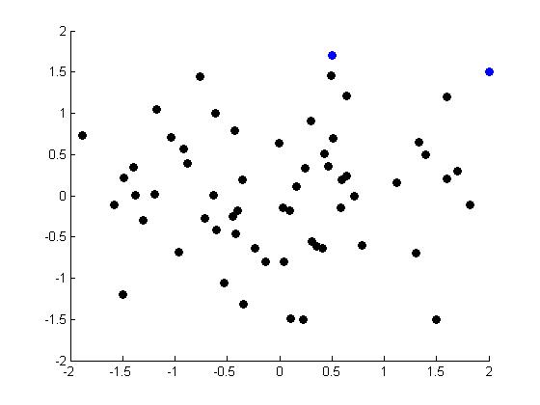
Data Visualization
Reduce features from 50 to 2.
The vectors Z₁ and Z₂ summarize the features in some way
Z₁
Z₂
Country
Canada | 1.6 | 1.2
China | 1.7 | 0.3
India | 1.6 | 0.2
Russia | 1.4 | 0.5
Singapore | 0.5 | 1.7
USA | 2 | 1.5
… | … | …
Z₂
Per-person
GDP
Z₁
Country-size GDP

Slide 26
Method for Dimensionality Reduction
Principle Component Analysis (PCA)
One of the most popular methods

Slide 27
Principal Component Analysis (PCA) problem formulation
What are we trying to do? We want to reduce the dimensions from 2D to 1D
We want to find a line on to which to project the data
Distance between point x_{i} and the projected line is minimized… sum of squares is minimized.
This is called projection error
Notes:
Want to find a line on to which to project the data.
The distance between the point and the projected line (or these vectors)
So that the sum of squares are minimized…
Projection error vectors

Slide 28
Principal Component Analysis (PCA) problem formulation
What are we trying to do? We want to reduce the dimensions from 2D to 1D
Consider this new projection, the points have to move a huge distance to get projected onto this line.
Hence, the previous projection is better because it minimizes the error.
Notes:
Want to find a line on to which to project the data.
The distance between the point and the projected line (or these vectors)
So that the sum of squares are minimized…
Projection error vectors

Slide 29
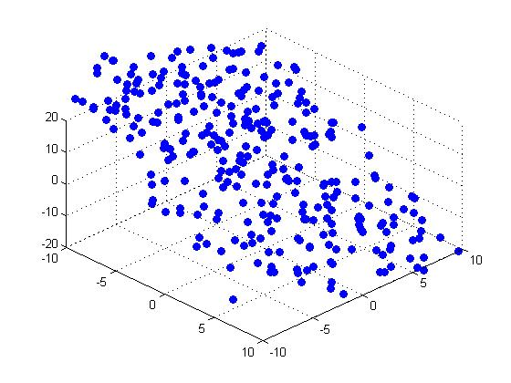
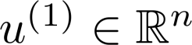


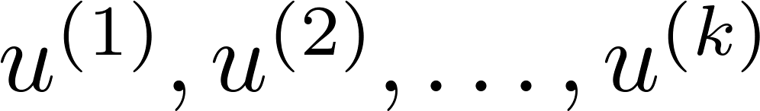
Principal Component Analysis (PCA) problem formulation
Reduce from 2-dimension to 1-dimension:
Find a direction a vector onto which to project the data so as to minimize the projection error.
Reduce from n-dimension to k-dimension: Find vectors
onto which to project the data, so as to minimize the projection error.
Notes:
Find a projection , called u1 to minimize the projection error
In multiple dimensions, we want to find multiple vectors u1, u2, u3 etc. that minimize the projection error.

Slide 30
Principal Component Analysis (PCA) problem formulation
Z
Notes:
Find a projection , called u1 to minimize the projection error

Slide 31
Principal Component Analysis
30
So what are principal components then?
Underlying structure in the data.
They are the directions where there is the most variance, the directions where the data is most spread out.
All principal components (PCs) start at the origin of the ordinate axes.
First PC is direction of maximum variance from origin
Subsequent PCs are orthogonal to 1st PC and describe maximum residual variance
25
20
PC 1
Wavelength 2
15
10
5
0
0
5
10
15
20
25
30
Wavelength 1
30
25
20
PC 2
Wavelength 2
15
10
5
0
0
5
10
15
20
25
30
Wavelength 1

Slide 32
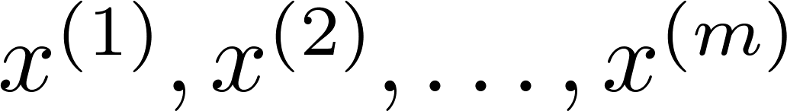
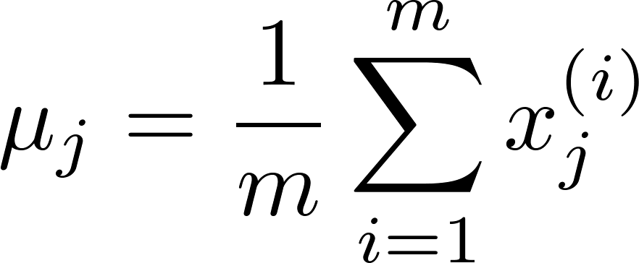
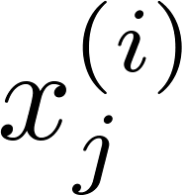

Step 1 - Data Preprocessing
Training set:
Preprocessing (feature scaling/mean normalization):
Replace each with
Then divide each term ( ) by the standard deviation σ ( or you can also divide by X_{max}-X_{min})
Notes:
Mean normalization
- Compute the mean for each features
Update each feature by subtracting the mean
And if the features have a different scale, then divide by standard deviation

Slide 33
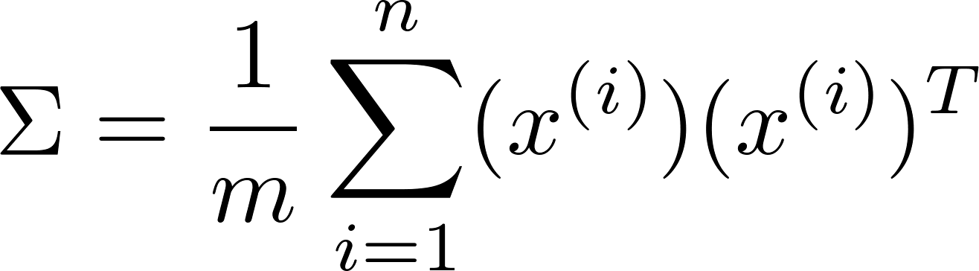
Step 2 – Apply PCA
Reduce data from n-dimensions to k-dimensions
Compute “covariance matrix”:
measure of how much two random variables change together
nxn
nx1
1xn
Compute “eigenvectors” of matrix :
Use SVD – Single Value Decomposition
Eigenvector is a direction
Every eigenvector has a eigenvalue, which is the variance in the data in that direction.
The eigenvector with the highest eigenvalue is therefore the principal component.
Notes:
Compute the covariance matrix (sigma)
Using SVD to get the eigenvectors

Slide 34
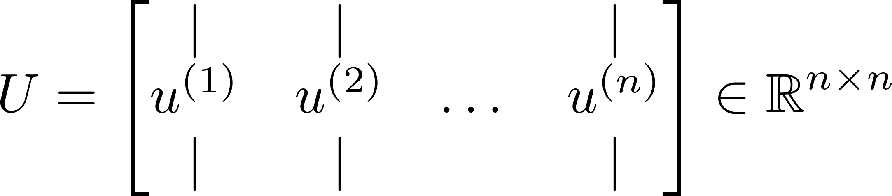
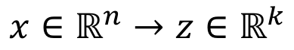
Step 2 – Apply PCA (Cont.)
How to compute the eigenvector?
Apply SVD (Single Value Decomposition) on covariance matrix to get [U,S,V] matrices.
If we want to reduce the dimensions from n to k
Then we simply take the k vectors u¹, u², …, u^{k}
T
z =
k
x
K vectors
u_{Reduced}

Slide 35

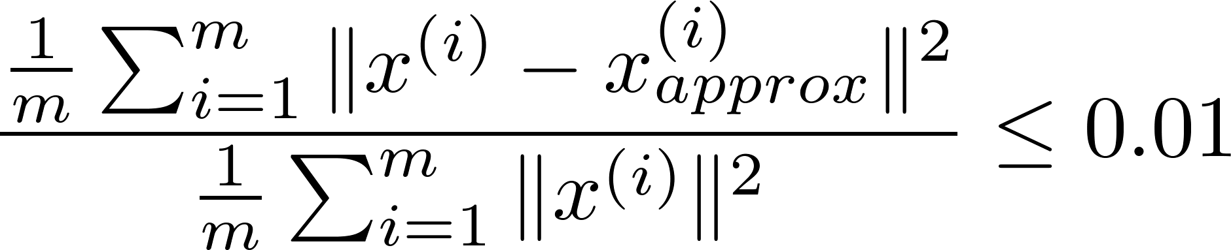
Choose ‘k’ Number of principle components
Average squared projection error:
Total variation in the data:
Typically, choose to be smallest value so that
“99% of variance is retained”
(1%)

Slide 36
PCA Example (Spark / python)
See pca_example.py under <SPARKPATH>/examples/src/main/python/ml
data = [(Vectors.sparse(5, [(1, 1.0), (3, 7.0)]),), \
(Vectors.dense([2.0, 0.0, 3.0, 4.0, 5.0]),), \
(Vectors.dense([4.0, 0.0, 0.0, 6.0, 7.0]),)]
df = spark.createDataFrame(data, [ "features” ])
pca = PCA(k=3, inputCol= "features", outputCol= "pcaFeatures")
model = pca.fit(df)
result = model.transform(df).select( "pcaFeatures” )
result.show(truncate=False)
A dataframe is a dataset (think about a matrix) that is organized into “named” columns.
WAIT!!! What about preprocessing the data by feature scaling and mean normalization!!!

Slide 37
PCA Example (Spark / python)
See standard_scaler_example.py under <SPARKPATH>/examples/src/main/python/mlib/standard_scaler_example.py
data = MLUtils.loadLibSVMFile(sc, "data/mllib/sample_libsvm_data.txt")
dataFrame = sqlContext.createDataFrame(data)
scaler = StandardScaler(inputCol="features", outputCol="scaledFeatures",
withStd=True, withMean=False)
# Compute summary statistics by fitting the StandardScaler
scalerModel = scaler.fit(dataFrame)
# Normalize each feature to have unit standard deviation.
scaledData = scalerModel.transform(dataFrame)
You can specify which to apply, or apply both

Slide 38
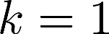
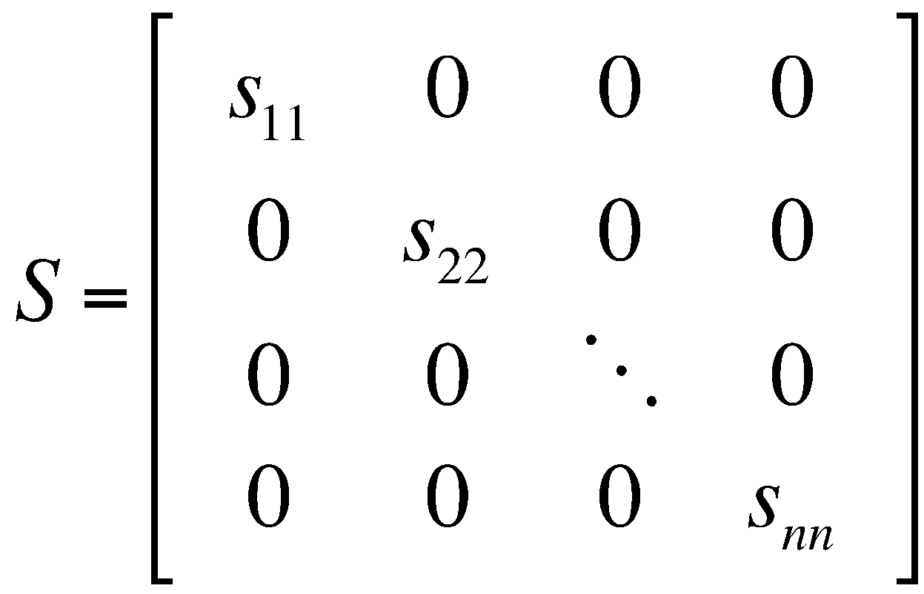


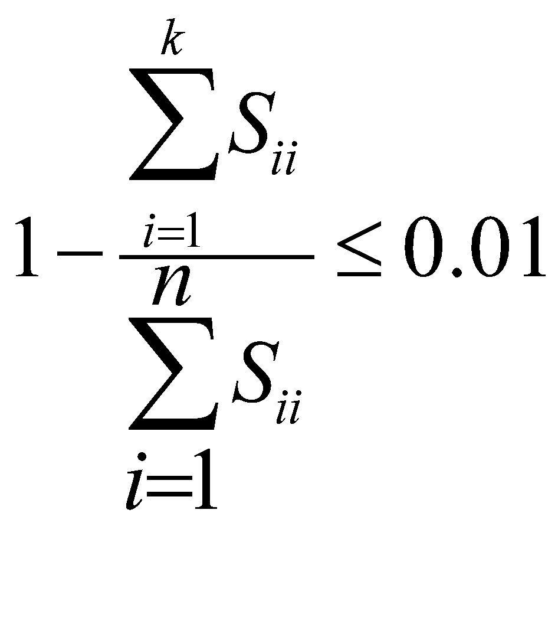
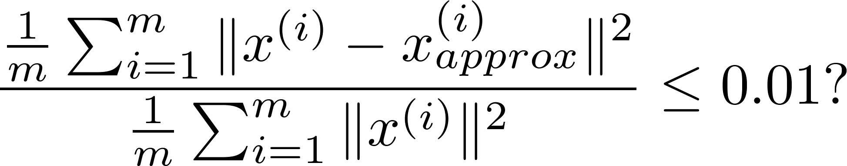
Choose ‘k’ Number of principle components
Algorithm:
Try PCA with
Compute
Check if
[U,S,V] = svd(Sigma)
K =2
Avg squared projection error
For a given k,
Total variation in the data
Notes:
Average squared projection error

Slide 39
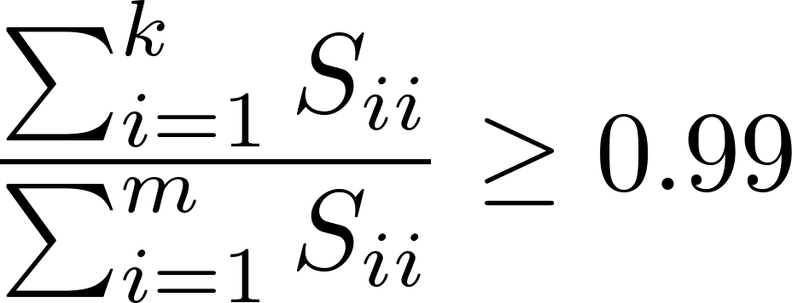
Choose k’ Number of principle components
[U,S,V] = svd(Sigma)
Pick smallest value of for which
(99% of variance retained)

Slide 40

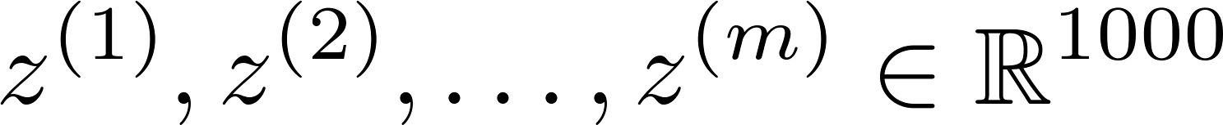
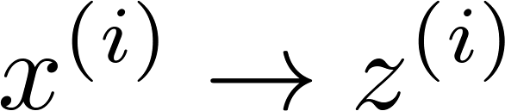
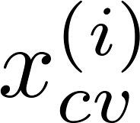
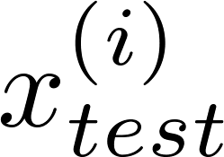
Supervised Learning Speedup
Extract inputs:
Unlabeled dataset:
New training set:
Note: Mapping should be defined by running PCA only on the training set. This mapping can be applied as well to the examples and in the cross validation and test sets.

Slide 41
Application of PCA
Compression
Reduce memory/disk needed to store data
Speed up learning algorithm
Visualization

Slide 42
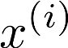
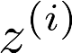
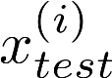
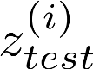
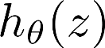
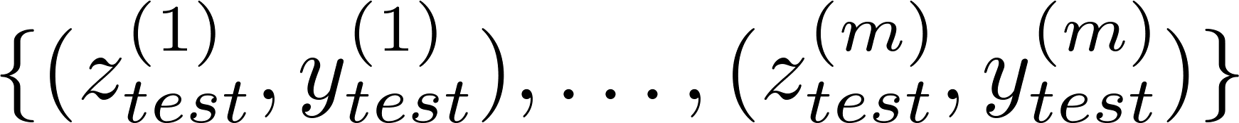
When to use PCA?
Design of ML system:
Get training set
Run PCA to reduce in dimension to get
Train classifier
Test on test set: Map to . Run on
How about doing the whole thing without using PCA?
Before implementing PCA, first try running whatever you want to do with the original/raw data . Only if that doesn’t do what you want, then implement PCA and consider using

Slide 43
A 2D Numerical Example

Slide 44
PCA Example – STEP 1
Subtract the mean from each of the data dimensions.
All the x values have x subtracted and y values have y subtracted from them. This produces a data set whose mean is zero.
Subtracting the mean makes variance and covariance calculation easier by simplifying their equations.
The variance and co-variance values are not affected by the mean value.

Slide 45
PCA Example –STEP 1
DATA:
x y
2.5 2.4
0.5 0.7
2.2 2.9
1.9 2.2
3.1 3.0
2.3 2.7
2 1.6
1 1.1
1.5 1.6
1.1 0.9
ZERO MEAN DATA:
x y
.69 .49
-1.31 -1.21
.39 .99
.09 .29
1.29 1.09
.49 .79
.19 -.31
-.81 -.81
-.31 -.31
-.71 -1.01

Slide 46
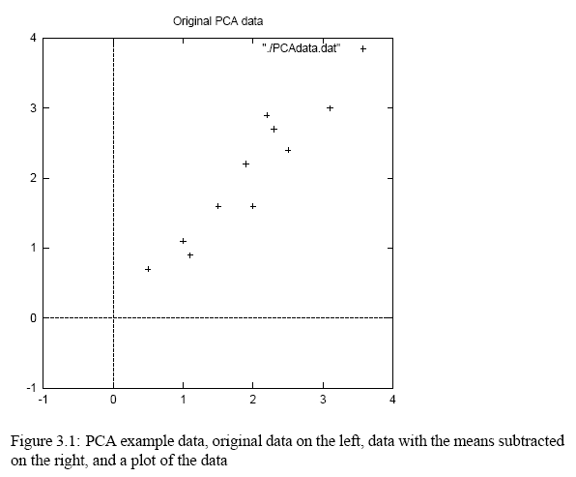
PCA Example –STEP 1

Slide 47
PCA Example –STEP 2
Calculate the covariance matrix
cov = .616555556 .615444444
.615444444 .716555556
since the non-diagonal elements in this covariance matrix are positive, we should expect that both the x and y variable increase together.

Slide 48
PCA Example –STEP 3
Calculate the eigenvectors and eigenvalues of the covariance matrix
eigenvalues = .0490833989 1.28402771
eigenvectors = -.735178656 -.677873399 .677873399 -.735178656

Slide 49
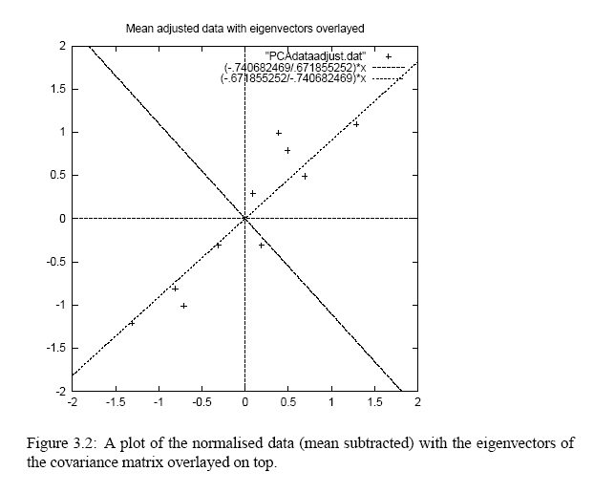
PCA Example –STEP 3
eigenvectors are plotted as diagonal dotted lines on the plot.
Note they are perpendicular to each other.
Note one of the eigenvectors goes through the middle of the points, like drawing a line of best fit.
The second eigenvector gives us the other, less important, pattern in the data, that all the points follow the main line, but are off to the side of the main line by some amount.

Slide 50
PCA Example –STEP 4
Reduce dimensionality and form feature vector
the eigenvector with the highest eigenvalue is the principle component of the data set.
In our example, the eigenvector with the larges eigenvalue was the one that pointed down the middle of the data.
Once eigenvectors are found from the covariance matrix, the next step is to order them by eigenvalue, highest to lowest. This gives you the components in order of significance.

Slide 51
PCA Example –STEP 4
Now, if you like, you can decide to ignore the components of lesser significance.
You do lose some information, but if the eigenvalues are small, you don’t lose much
n dimensions in your data
calculate n eigenvectors and eigenvalues
choose only the first p eigenvectors
final data set has only p dimensions.

Slide 52
PCA Example –STEP 4
Feature Vector
FeatureVector = (eig1 eig2 eig3 … eign)
We can either form a feature vector with both of the eigenvectors:
or, we can choose to leave out the smaller, less significant component and only have a single column:
-.677873399 -.735178656
-.735178656 .677873399
.677873399
.735178656

Slide 53
PCA Example – STEP 5
Deriving the new data
FinalData = RowFeatureVector x RowZeroMeanData
RowFeatureVector is the matrix with the eigenvectors in the columns transposed so that the eigenvectors are now in the rows, with the most significant eigenvector at the top
RowZeroMeanData is the mean-adjusted data transposed, ie. the data items are in each column, with each row holding a separate dimension.

Slide 54
PCA Example –STEP 5
FinalData transpose: dimensions along columns
x y
-.827970186 -.175115307
1.77758033 .142857227
-.992197494 .384374989
-.274210416 .130417207
-1.67580142 -.209498461
-.912949103 .175282444
.0991094375 -.349824698
1.14457216 .0464172582
.438046137 .0177646297
1.22382056 -.162675287

Slide 55

PCA Example –STEP 5

